Slide 1

Ocean circulation
With Satellite Altimetry and GOCE
Shivam Pandey 17807671
Sarvesh Chaudhary 170637

Slide 2

Satellite Altimetry
Sea Surface Height [h]

Slide 3
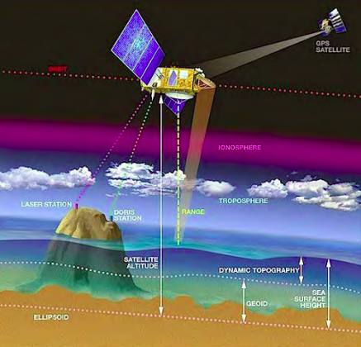
Herceg et.al

Slide 4
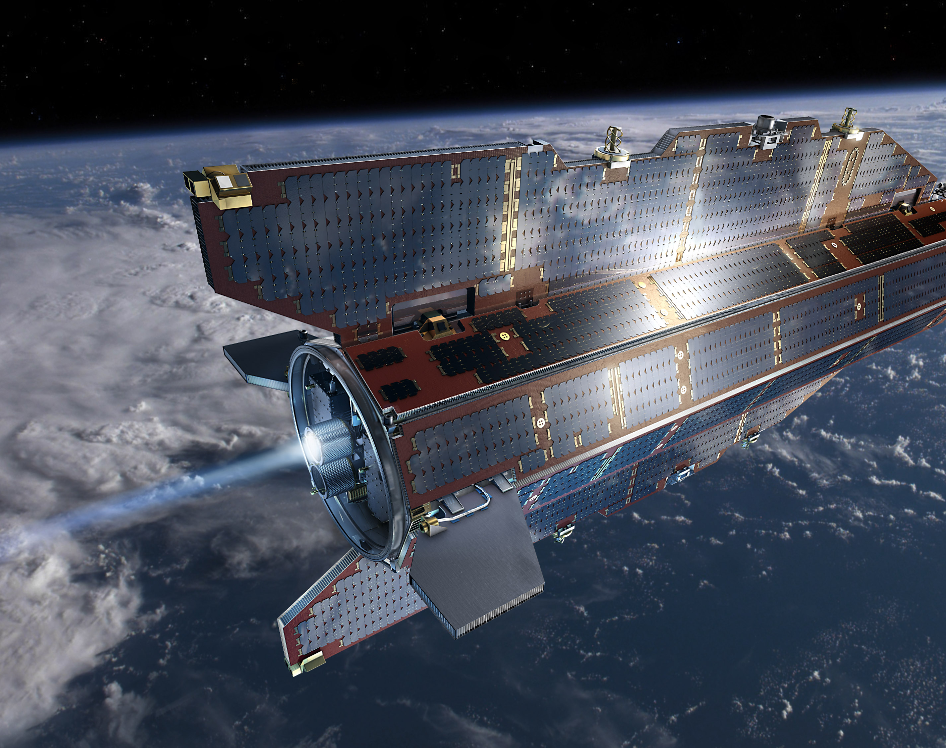
Gravity Field and Steady-State Ocean Circulation Explorer

Slide 5
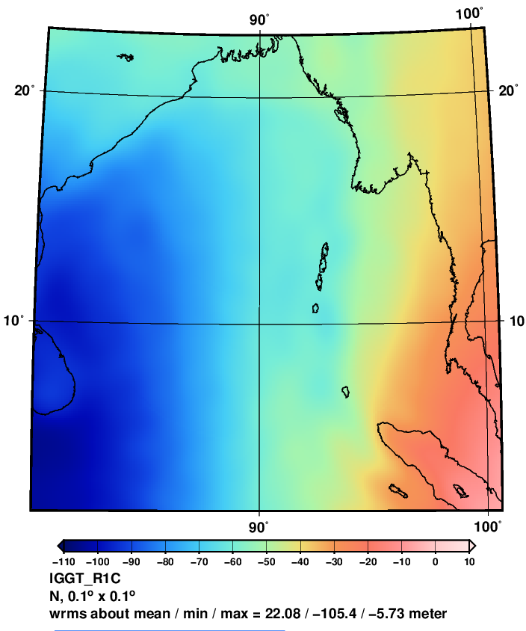
Geoid from GOCE [N]
Provides the Gravity measurement with higher spatial resolution.
Previously used GRACE was meant to provide higher temporal resolution but due to use of larger wavelength was unable to provide much better precision on higher spatial resolution.

Slide 6
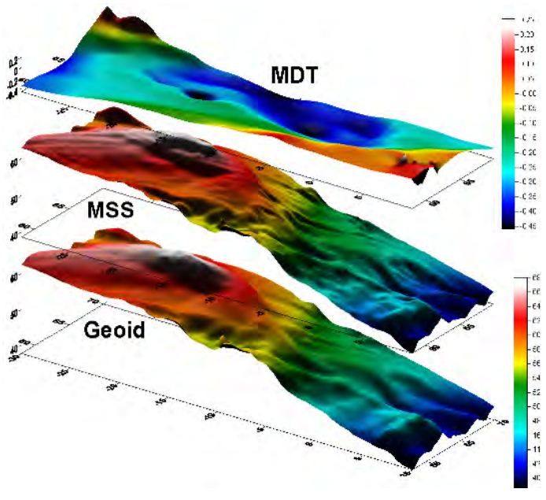
Mean Dynamic Topography
IDT = SSH – Geoid
SSH is disturbed by local factors like moving objects etc.
MDT = mean SSH – Geoid
Repeated Track Method is applied to the Satellite Altimetry.
Proceed with the stationary geoid assumption
Christian, Carl

Slide 7

Data Filtering
Due to several remaining error sources, geodetic MDTs are usually filtered before ocean currents are calculated.
Gaussian (Binghum 2014)
Other Spatial Averaging (Binghum 2014)
Non-Liner diffusion [Used for steep gradients](Binghum 2010)

Slide 8
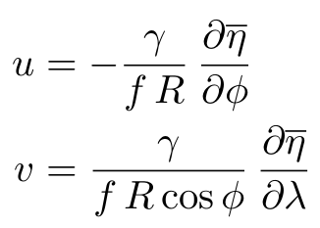

MDT

Slide 9
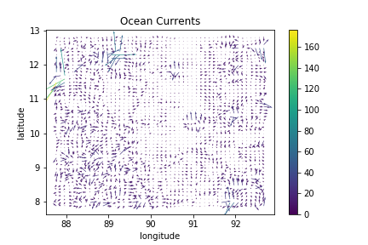
Expected Results

Slide 10
Steps to Follow
Geoid
Get the Geoid (stationary assumption) N
SSH
Compute the time average for the Sea surface height n
MDT
Get the Mean Dynamic Topography (MDT) n-N
Filter
Filter the MDT to remove the noise and residual errors
Current
Get the current components for each of the grid u, v
PCA
Try to track the trends in the currents either by Principal Component Analysis or some other model.

Slide 11

Dataset

Slide 12
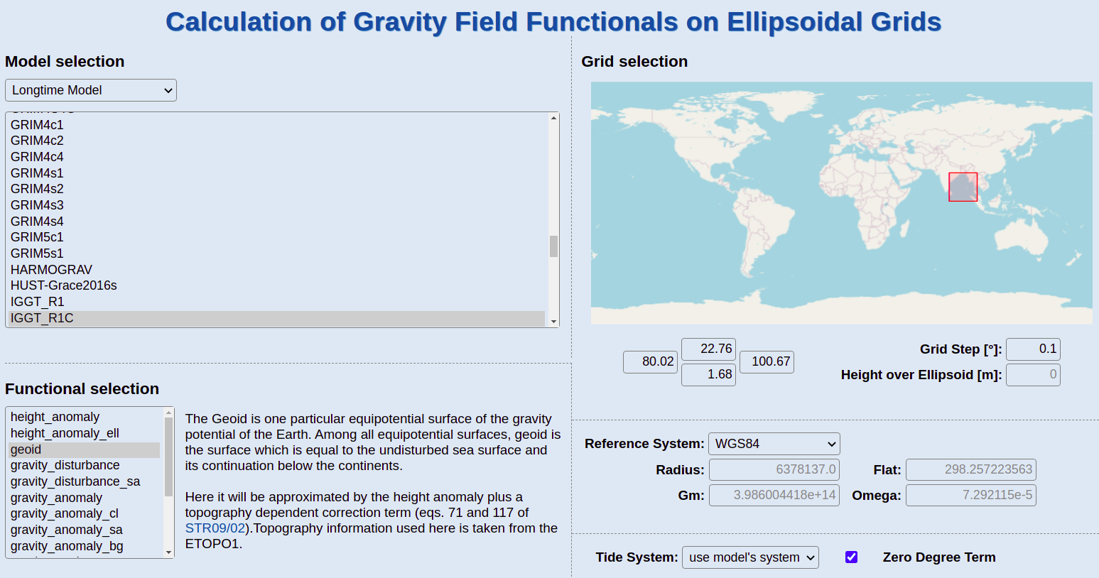

Slide 13
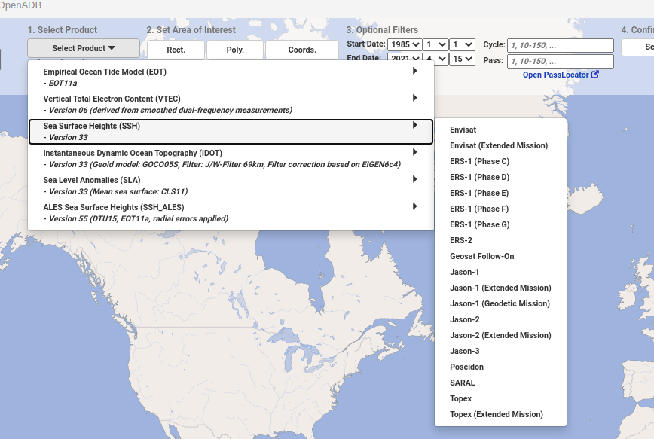
SSH Data for JASON2 and SARAL

Slide 14
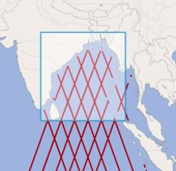
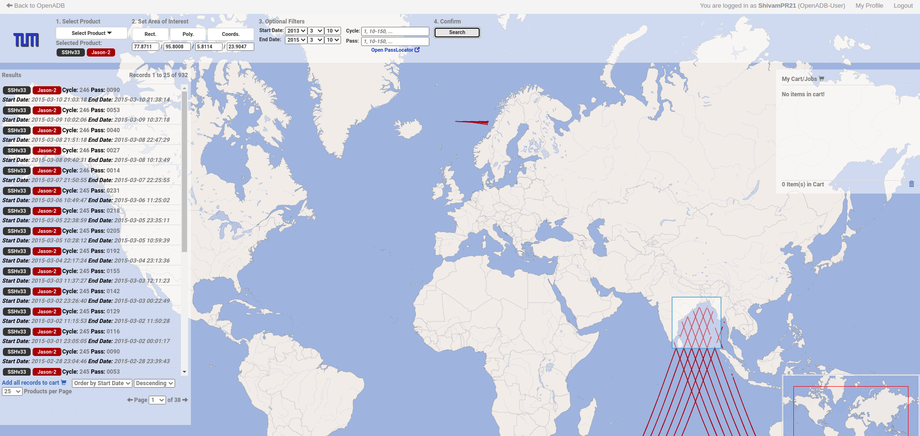

Slide 15
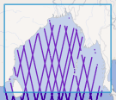
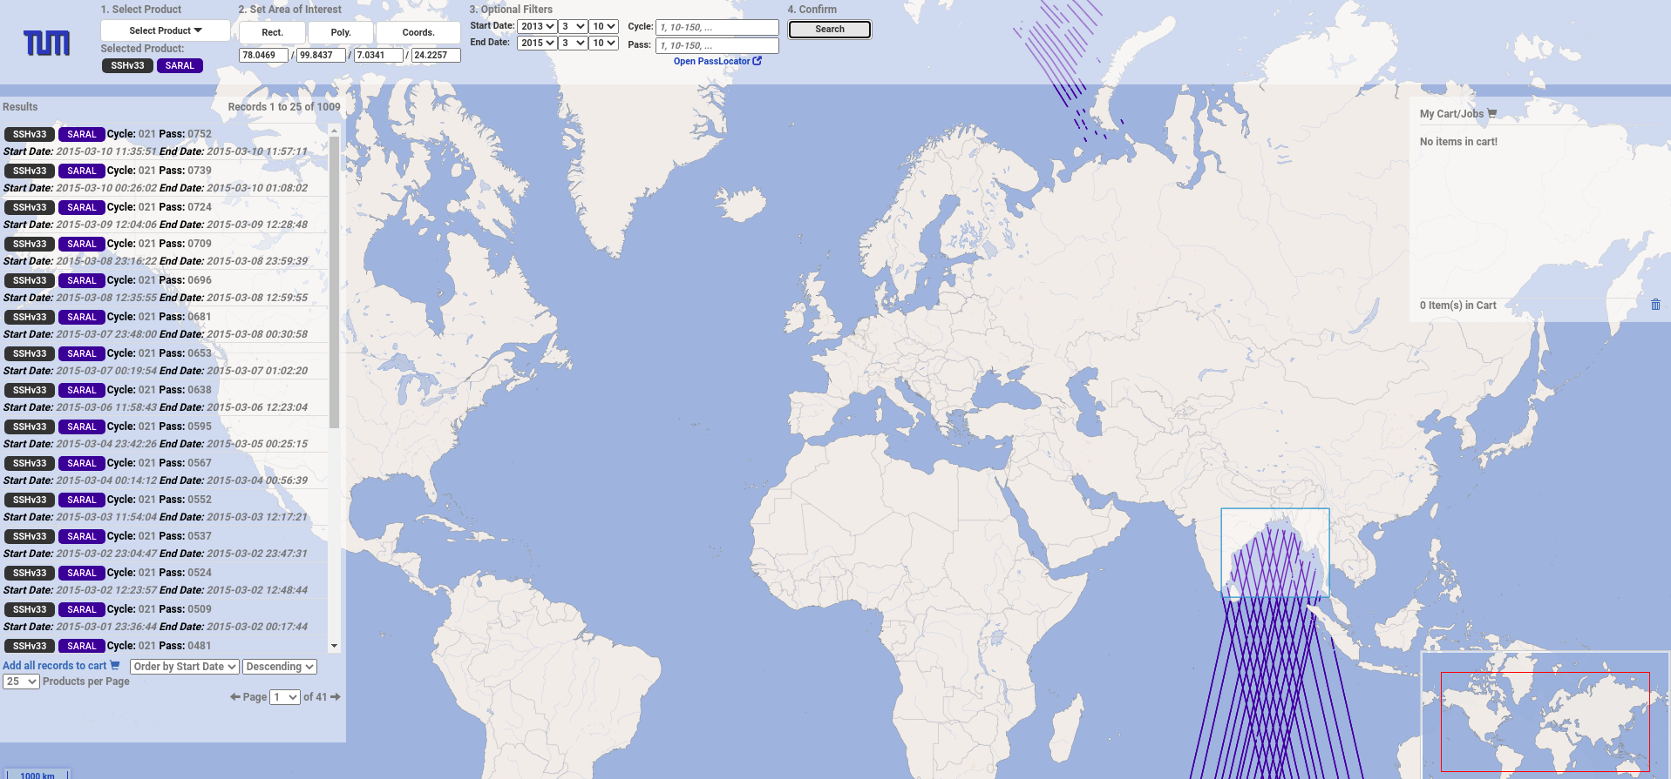

Slide 16
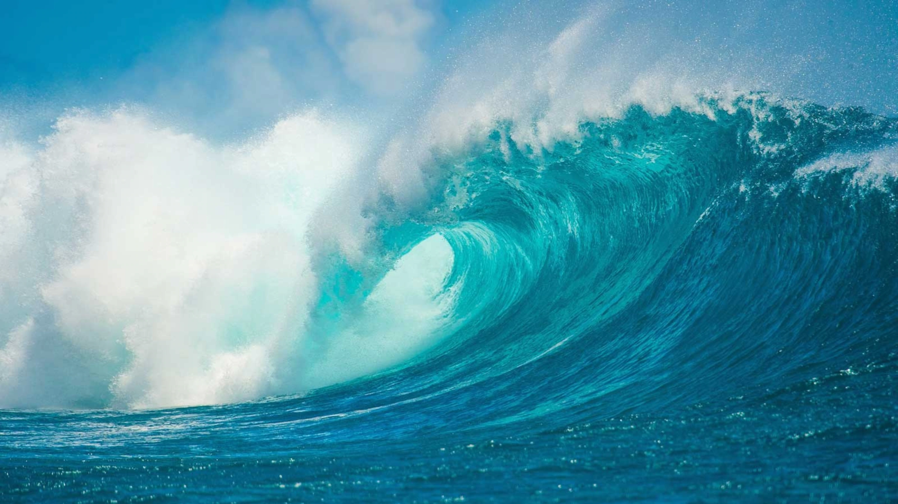
Say Hi to GOCEAN
A Library to Probe-inside Ocean Currents

Slide 17

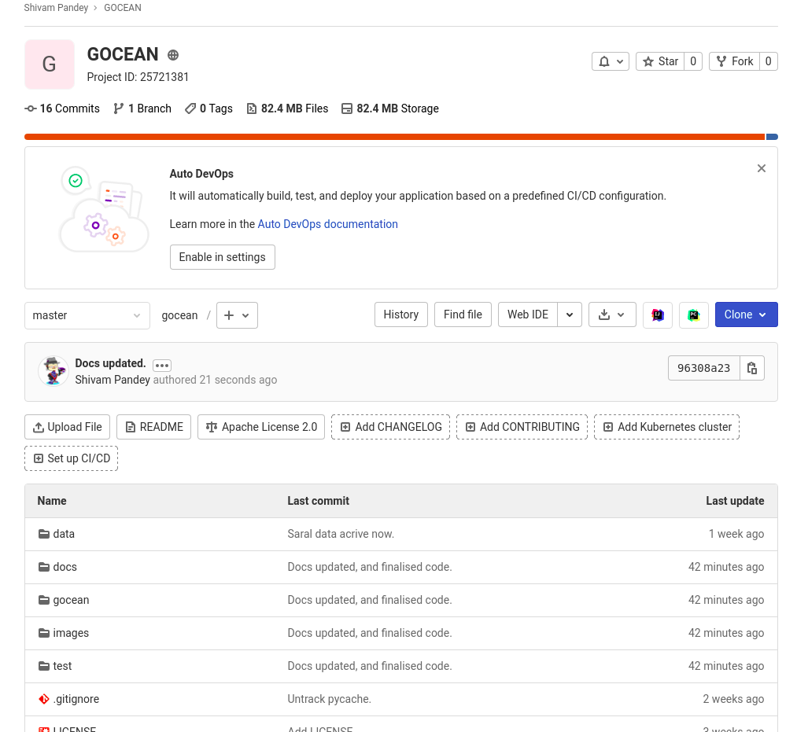

Slide 18
Modules in GOCEAN
I/O
geoid
SSHIO
Preprocessing
Noise Filtering
Smoothing
Currents
MDT
Components
Analysis
K-means clustering
PCA dimension change
GeoidIO
Altimetry

Slide 19

SSH Data Acquisition with OpenADB

Slide 20
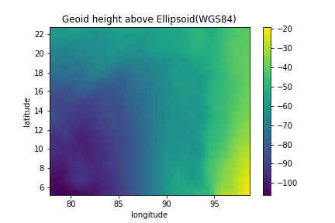
GeoidIO

Slide 21
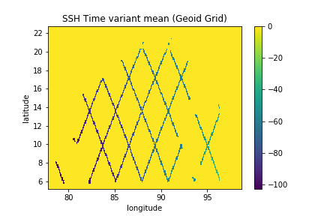
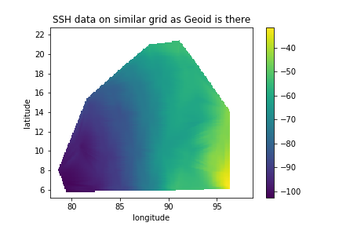
SSHIO
Create a grid like Geoid-grid 1x1.
For each readings of SSH get the closest location in the grid.
Apply average for each point.

Slide 22
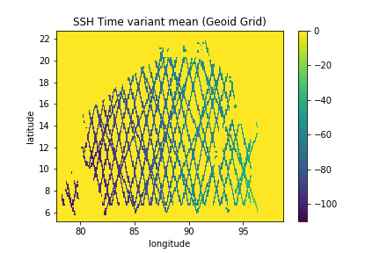
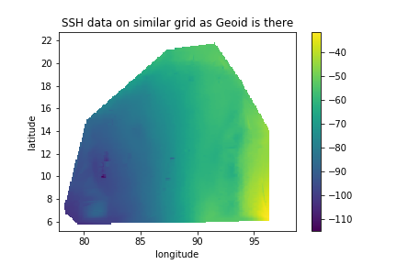
Added Data for SARAL

Slide 23
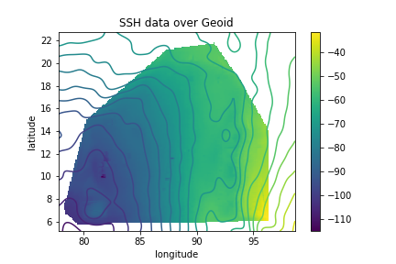
SSH Temporal Mean and Geoid

Slide 24
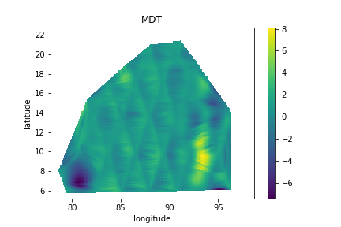
MDT calculated with JASON2 Data

Slide 25
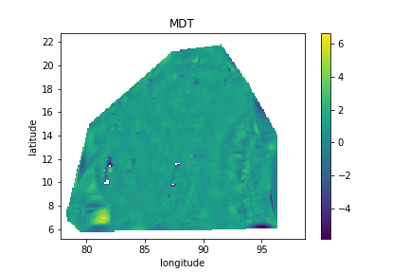
MDT after outlier removal

Slide 26

MDT filtered 2D Gaussian
Notes:
Gaussian filtering
Mean dynamic topography

Slide 27
MDT
Latitude
Longitude

Slide 28
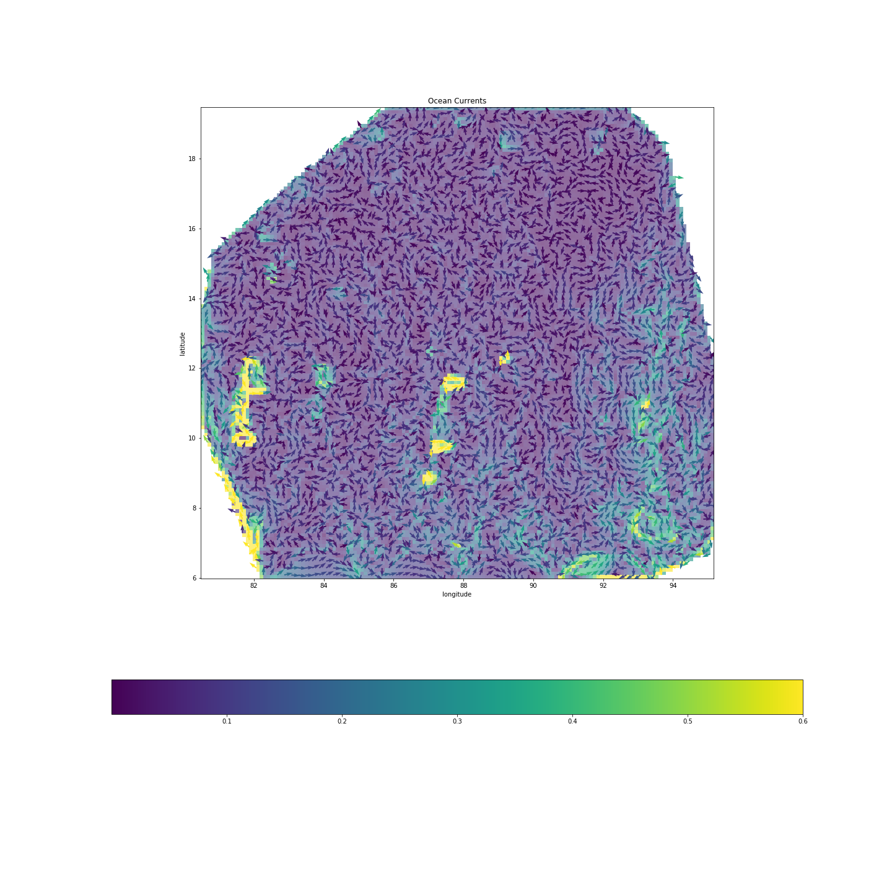
OCEAN Currents

Slide 29
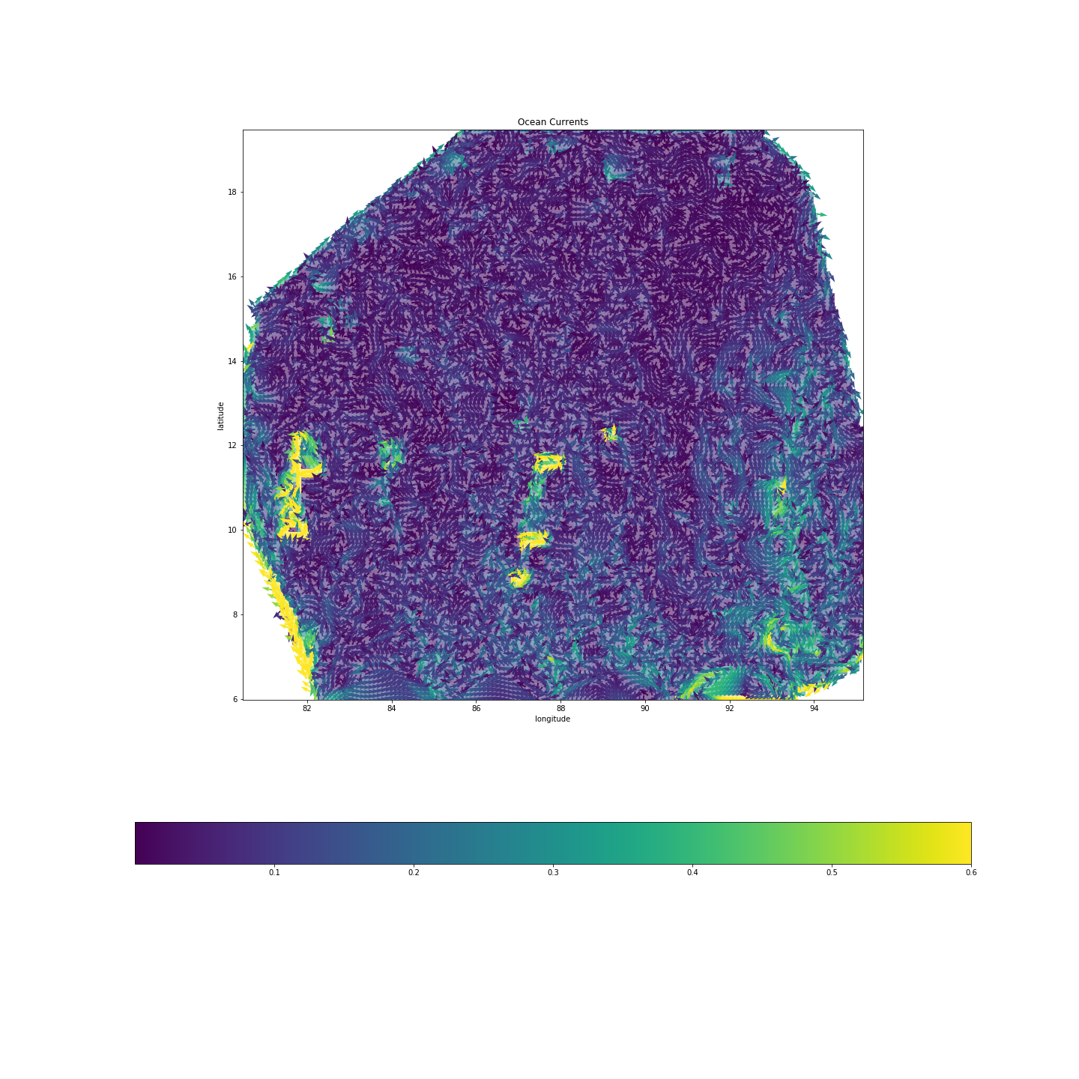
Ocean Currents
Notes:
Differentiating MDT wrt longitude and lattitude

Slide 30

Visualize it Closer

Slide 31
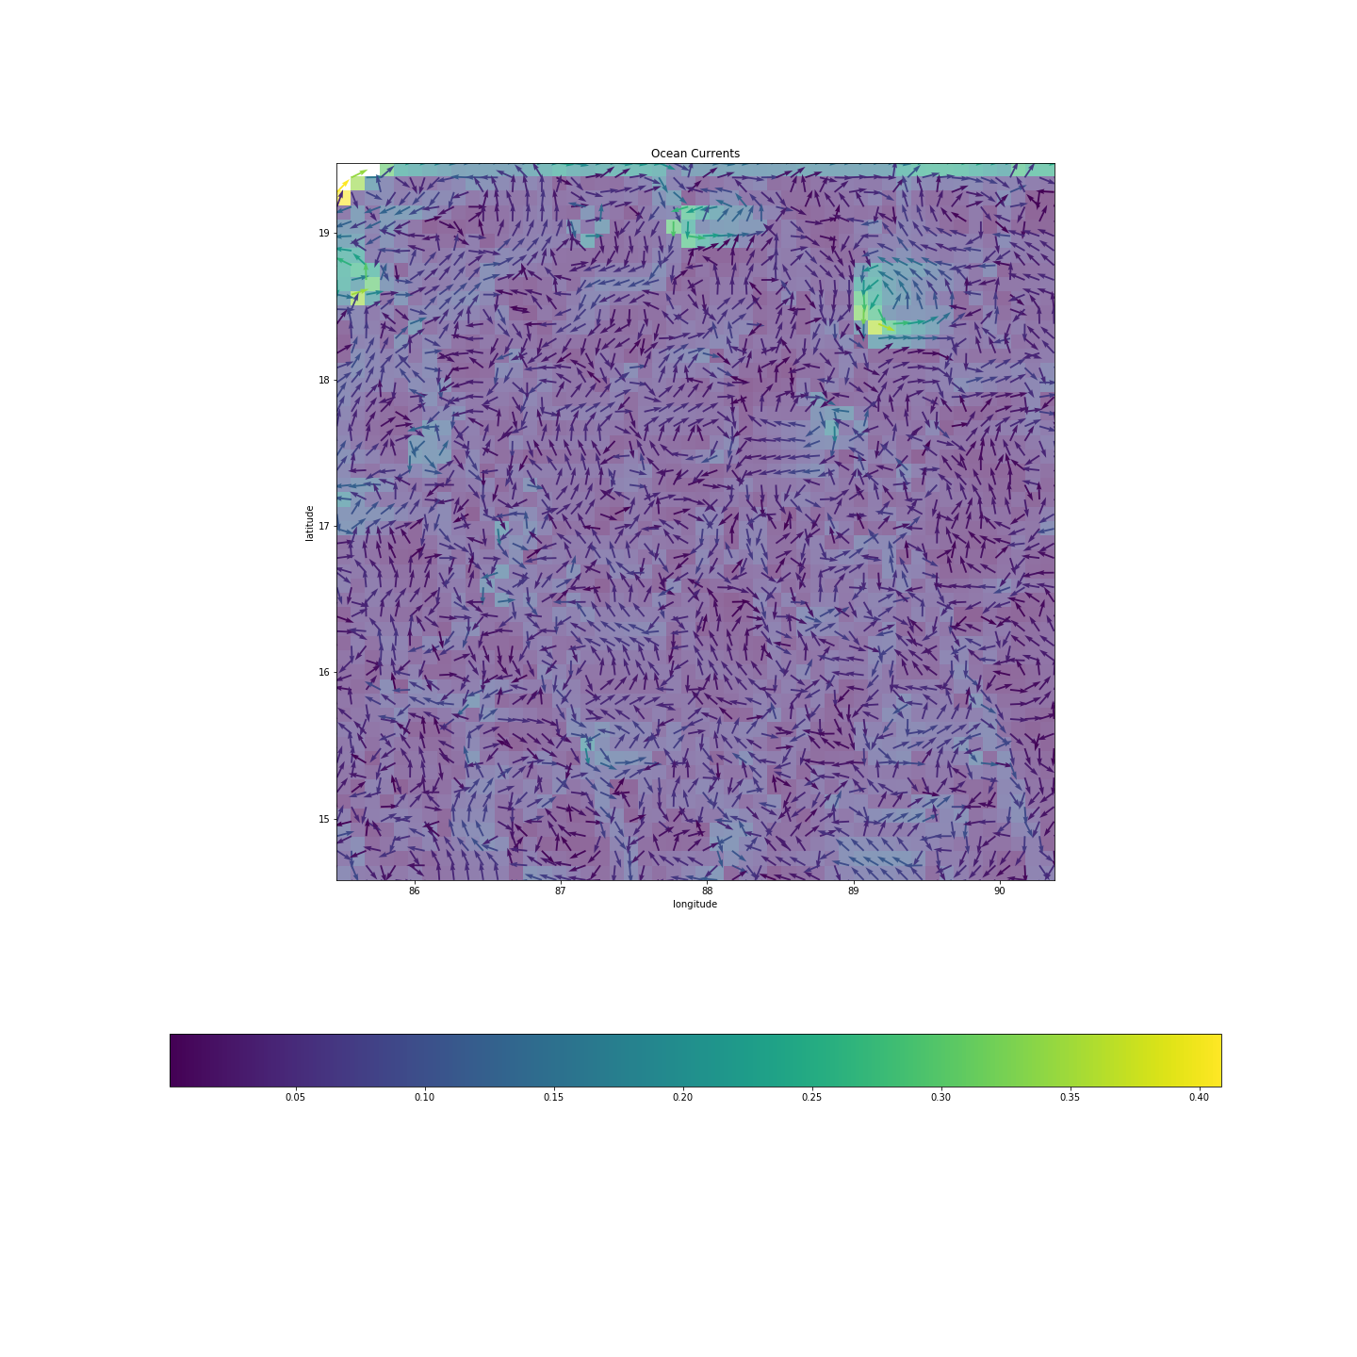
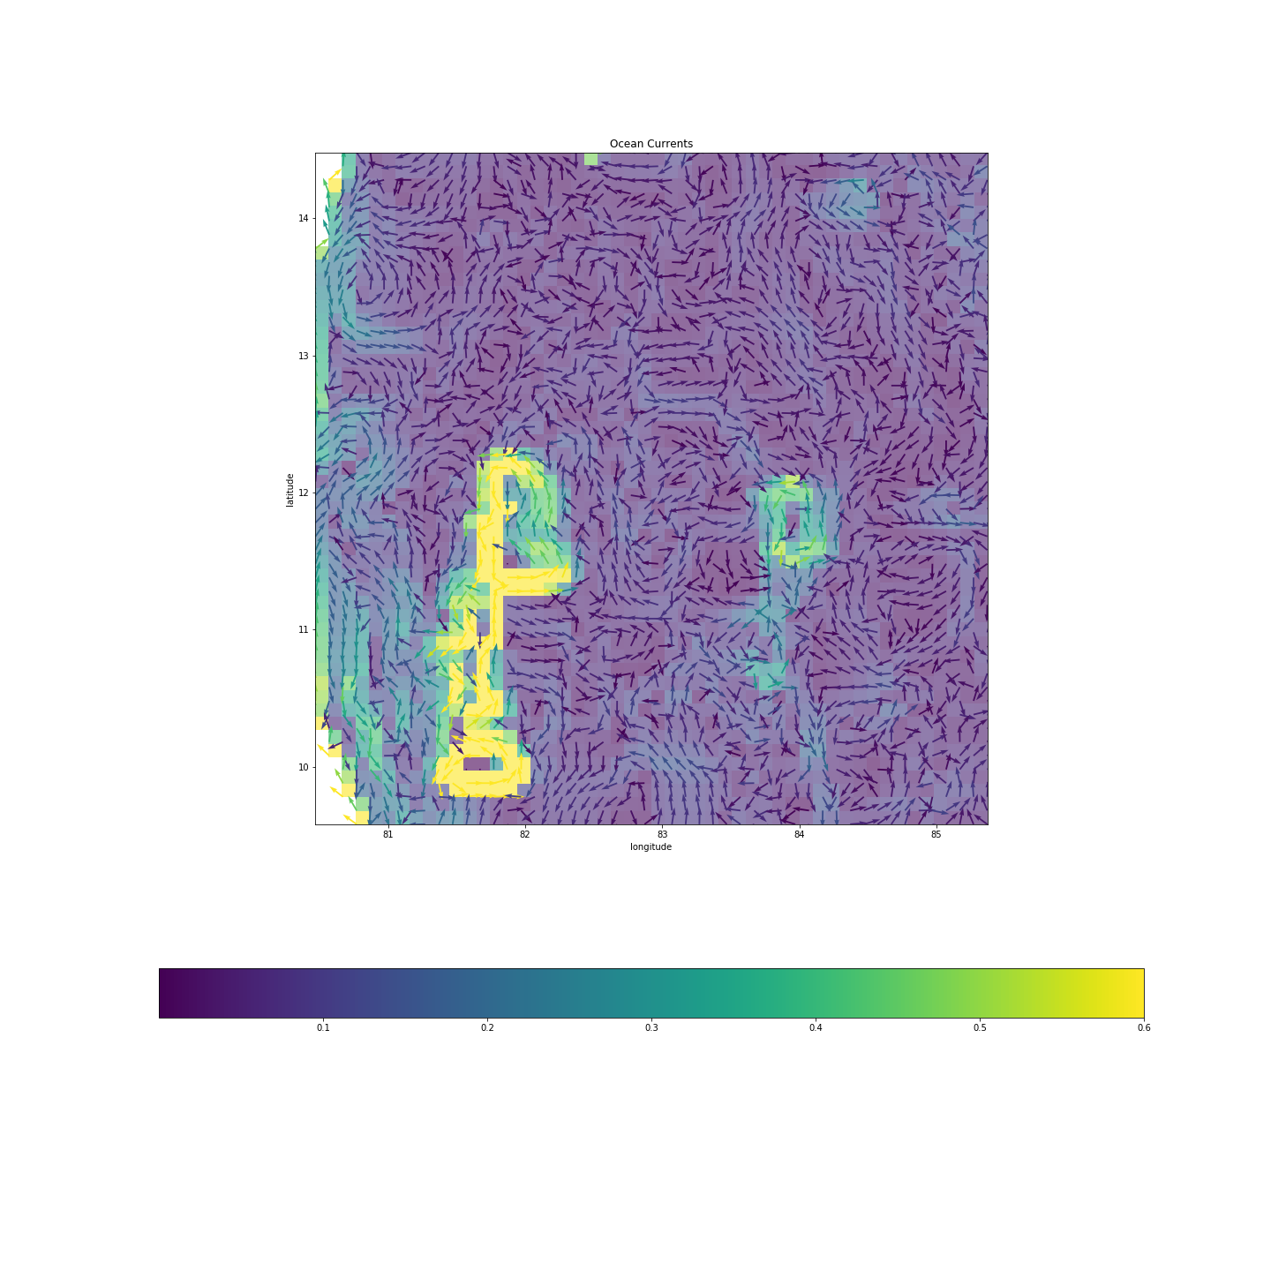

Slide 32
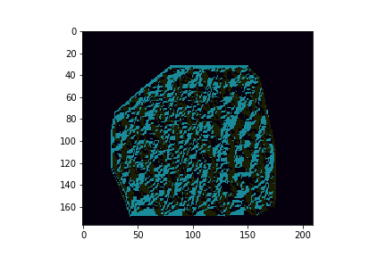
Clustering for Excess Interpretation [Experimental]

Slide 33
Reasons of k-means not working
The chaotic data at the boundaries.
Time lapse of the data is too small for any pattern.
The extent of data needs to be more.

Slide 34
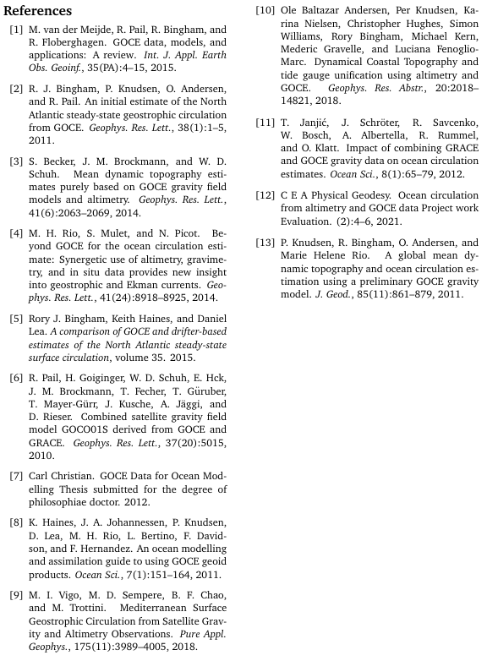
References

Slide 35

Thank You

